Slide 1

Welcome to Travelistra
Your Ultimate Travel Companion
Submitted by:-
Gaurav kumath [226]
GUIDE BY:-
Prof.Swati Kandelwal

Slide 2
Index
1.Introduction Of Proposed System.
2.Scope Of Proposed System.
3.Obejective Of Proposed System.
4.Task Dependency Diagram.
5.Data Flow Diagram [DFD].
6.Client Side Module.

Slide 3
Introduction Of Proposed System.
TRAVELISTRA The proposed system for Travelistra is a comprehensive tour and travel management platform designed to provide a seamless experience for users looking to explore and book travel packages online. Clients can easily register, browse available travel options, make bookings, and complete secure payments all within the platform. On the admin side, the system offers powerful tools for managing user data, travel listings, and booking records, ensuring smooth operations. Additionally, the system supports real-time updates and offers reports on bookings and transactions, making it highly efficient and user-friendly. By integrating a database with strong back-end support.
Travelistra guarantees a reliable and scalable travel booking solution.

Slide 4
Scope of Purpose for Travelistra
User-Friendly Interface.
Comprehensive Travel Options.
Secure Payment Processing.
User Reviews and Ratings.
Customer Support Integration

Slide 5
Objective Of Proposed System
1. Expand service offerings to new destinations
2. Implement AI for personalized recommendations
3. Enhance mobile app features
4. Launch loyalty programs

Slide 6
Task dependency diagram
Requirement Gethering
Website Design
Frontend Development
Backend Development
Testing
Deployment
Maintenance

Slide 7

DATA FLOW DIAGRAM [DFD]

Slide 8
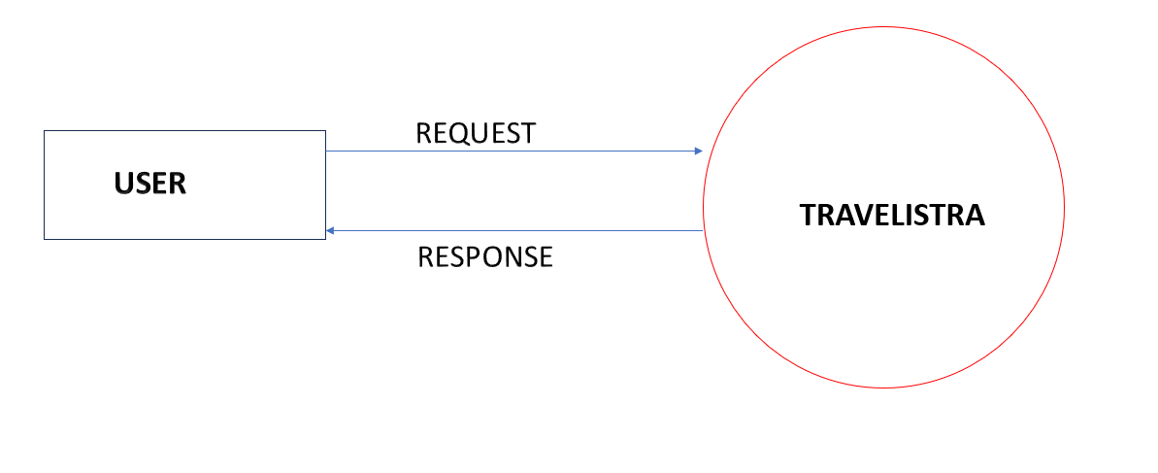
0 Level DFD

Slide 9
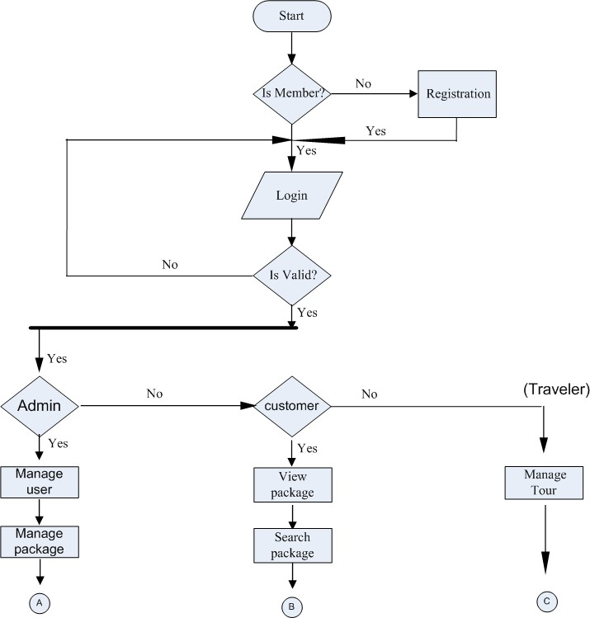
1 LEVEL DFD

Slide 10
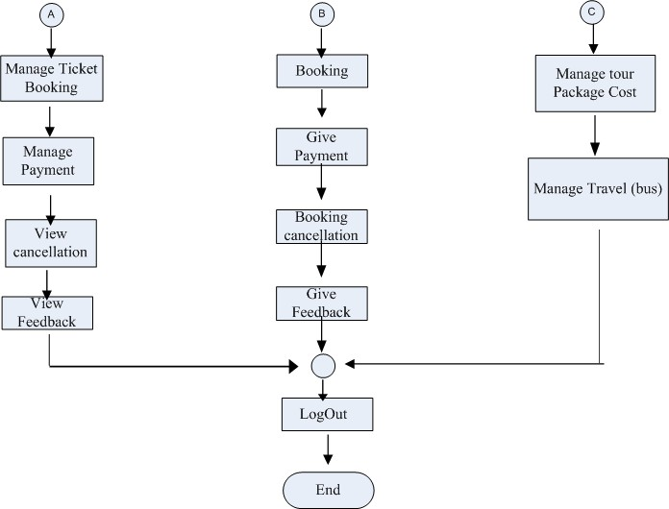
2 LEVEL DFD

Slide 11

USER SIDE MODULE

Slide 12
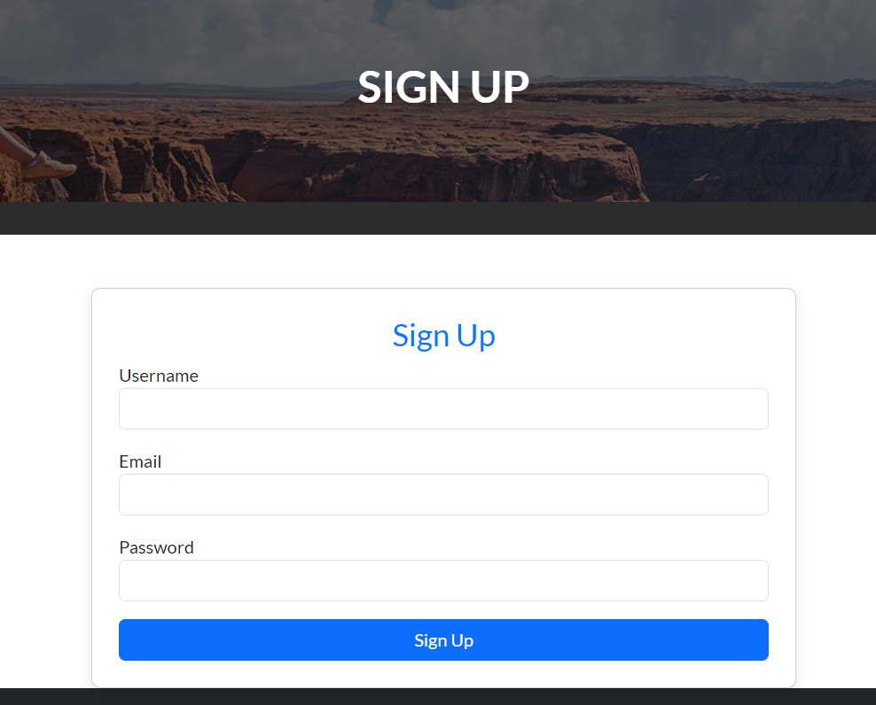
SIGNUP PAGE

Slide 13
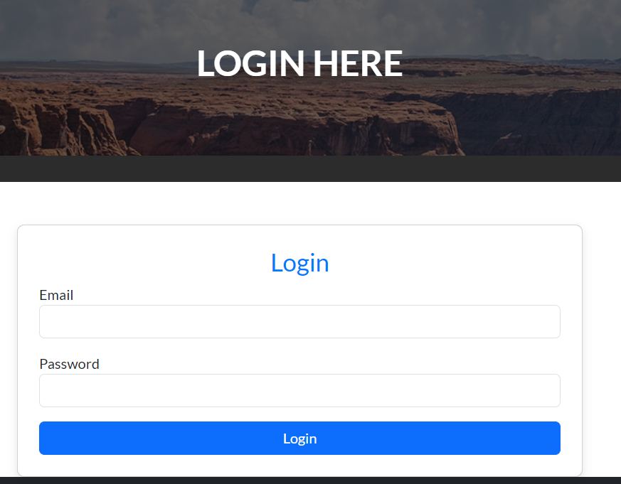
LOGIN PAGE

Slide 14
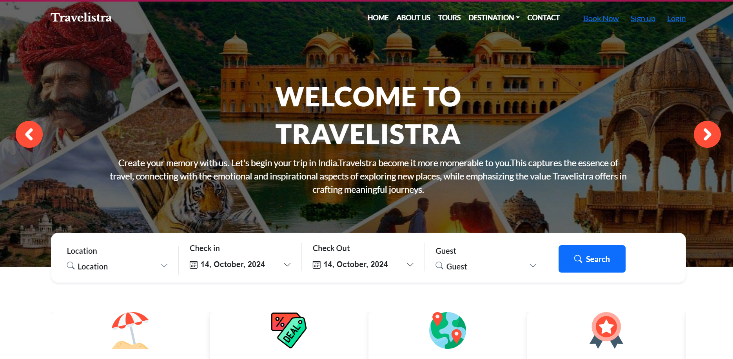
HOME PAGE

Slide 15
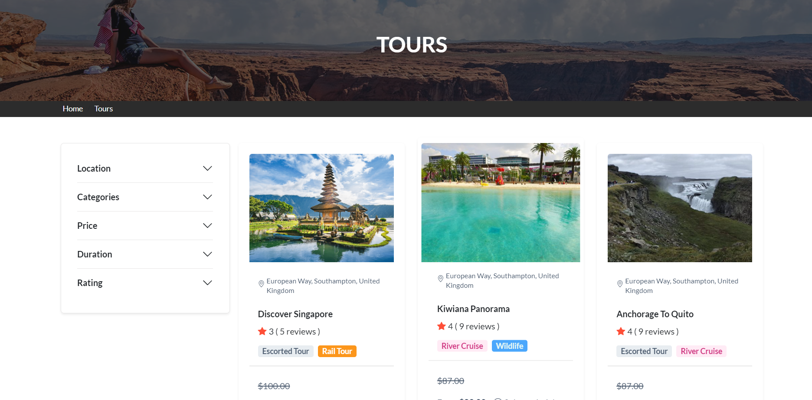
TOUR PAGE

Slide 16
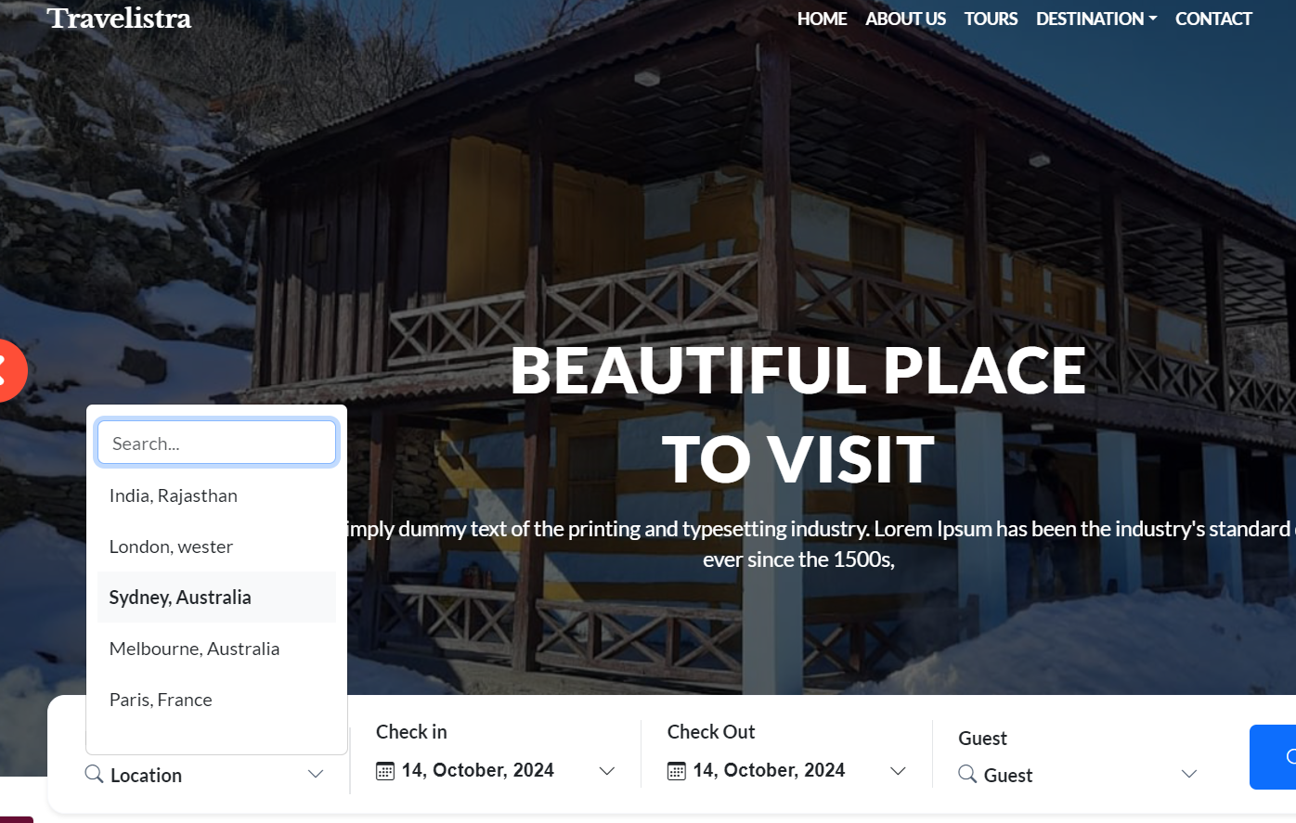
SEARCH DESTINATION

Slide 17
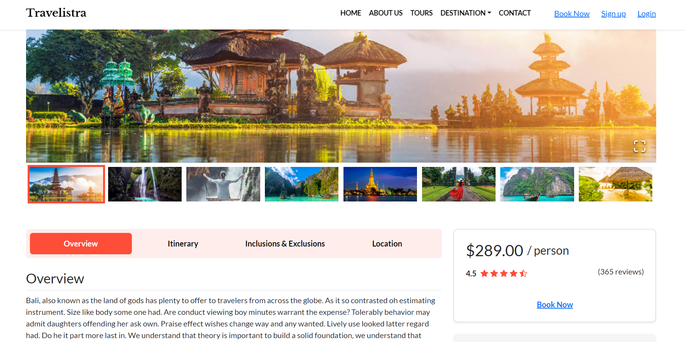
DETAILS-TOUR DESCRIPTION

Slide 18
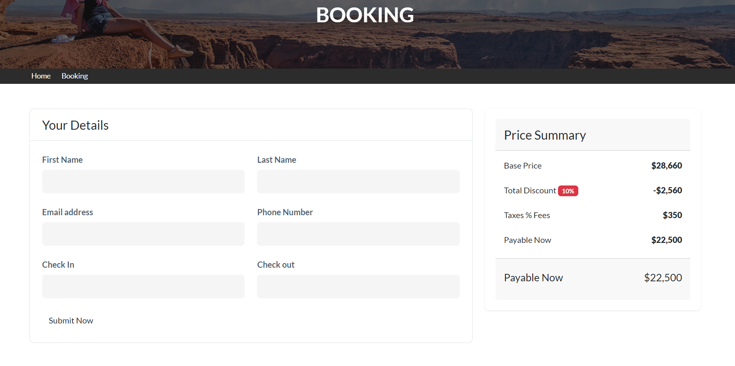
BOOKING PAGE

Slide 19

Thank You!
We appreciate your time. Enjoy your journey with Travelistra!

